Slide 1
Variability

Slide 2
Overview
Variability
What is it & why is it important?
Measures of variability (i.e., variation)
Range
Variance
Standard deviation
Calculations
Computation vs. definition formulas for Sums of Squares (SS)
Samples versus populations
Notes:
So, today we’re going to talk about variability.
We’ll discuss what it is and why it is important.
We’ll discuss several measures of variability, including range, variance, and standard deviation.
We’ll do some calculations.
And lastly, we’ll talk about what happens to the standard deviation when constants are changed.

Slide 3
Variability
Why do we care about variability?
Where would you like to vacation?
Gulfside Bungalows
M = 70
Kalahari Condos
M = 70
Day = 72
Night = 68
Day = 110
Night = 30
Notes:
Not long ago, we learned about measures of central tendency (mean, median, mode). Remember, measures of central tendency tell us about the ‘typical’ value in a set of scores.
However, measures of central tendency only provide limited information about a set of scores. So, I want to give you a reason to care about variability.
So, let’s talk about something that is of vital importance. Your vacation plans. Where would you rather vacation…
At Gulfside Bungalows, where the mean temperature is 70 degrees,
or Kalahari Condos where the mean temperature is 70 degrees?
Given this information, either place seem equally desirable.
But what if I told you in the daytime Gulfside Bungalows reaches about 72 degrees and in the nighttime about 68 degrees.
And in Kalahari Condos the daytime temperature can reach 110 degrees and can reach about 30 degrees in the evening.
Would your answer change? Yeah, probably.

Slide 4
Variability
In the past month, how many times have you had a serious disagreement or conflict with your significant other?
Sample 1: (n=3)
4
5
6
Mean = 5
Median = 5
Mode = none
Sample 2: (n=3)
1
5
9
Mean = 5
Median = 5
Mode = none
Notes:
Measures of central tendency are simply not enough to describe a sample (or population)
Two samples can have the same mean but look very different.
For example, if we took two samples and asked, “In the past semester, how many times have you had a serious disagreement or conflict with your significant other?”
Here we have two different samples, each with three individuals.
You can see the means, the medians, and the modes are the same for both samples.
But just looking at them, you can see that there is something different about the samples.
In this situation, our measures of central tendency are not fully capturing what is going on

Slide 5
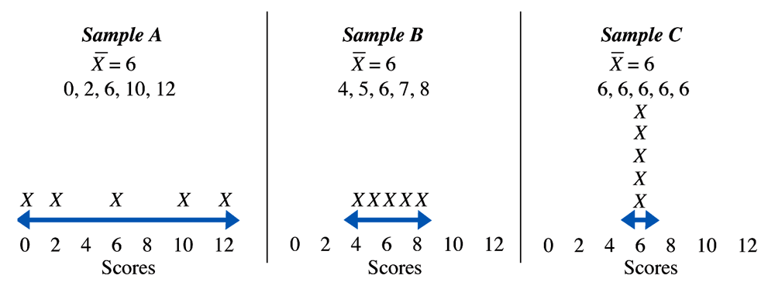
Measures of variability
Degree to which scores are spread out in a distribution
Gives us an idea about how well an individual or sample might represent population
Notes:
Imagine, I told you that someone scored a 210 on a test. That wouldn’t mean a lot to you unless you knew where that score was in RELATION to OTHER PEOPLE in the class.
Likewise, if I told you that the mean of the class was 210 that would not mean as much because you don’t have any idea of HOW VARIABLE these scores were.
Variability is the degree to which scores are spread out in a distribution.
Variability describes the distribution, usually in terms of distance.
In some data sets, the scores are tightly clustered around the mean. In other data sets, the scores are spread out.
This measure gives us an idea about how well an individual or sample might represent population
With ANY set of data, to really be able to interpret scores (what do these data mean), you will need to know the most likely score (i.e., some measure of central tendency) as well as some measure of how diverse the scores were.
Here you can see three different samples. In each sample, the mean is exactly the same (6). However, just looking at the scores you’ll notice that spread of the scores is very different.

Slide 6
Variability
Range
(Crude Range) Largest score minus smallest score
1, 3, 5, 7, 9
Range = 9 – 1 = 8
Only takes into consideration extreme scores
Notes:
The range is one measure of variability.
The range is typically given by the maximum and minimum values in a set. This is sometimes referred to as the crude range.
Imagine we have 5 scores (1, 3, 5, 7, 9).
The range is calculated by taking the upper limit (9) minus the lower limit (1).
Thus, our range is 8.
Although knowing the range can be informative, it is a very rough measure of variability.
The range only takes into consideration the largest and smallest values. It does not measure the variability of the rest of the dataset.

Slide 7
The Range
1 person
1 person
60 70 80 90 100
60 70 80 90 100
Mean = 80; Crude Range = 40
Notes:
Although the range can provide some information. It can sometimes be misleading
It may not give an accurate descriptive of the variability for the entire distribution.
In both the data sets presented, the range is the same. It is 40. But, you see that the distributions are very different.
As you can see, it is very sensitive to outliers.
So, it would be helpful to have another measure of variability that is not so heavily influenced by outliers and makes use of all the scores and not just the minimum and maximum.

Slide 8
Variability
2 common measures
Variance
Standard deviation
Degree to which a distribution varies from mean
Notes:
Two common measures of variability are variance and standard deviation.
They indicate the degree to which a distribution varies from the mean
That is, How much the scores spread out around the mean
We use the mean as our reference point since it is at the center of the distribution
These two values tell us how much on average individual scores “deviate from the mean”

Slide 9
Deviations from mean
X M (X-M)
4
5
6
5
5
5
-1
0
1
Deviation Scores
Σ(X-M)=0
We will always get 0 when we sum the deviation scores.
We have to make the deviations from the mean stop cancelling each other out.
Notes:
One way to quantify how much scores deviate from the mean would be to determine how much each score deviates, and then add that up.
So, imagine that we have a sample size of three. Three people score a 4, a 5, and a 6. This is our data set.
To calculate how much each score deviates from the mean, we first have to figure out what the mean is.
Remember the formula for a mean is the sum of X divided by n. 4+ 5 + 6 is 15. 15 divided by 3 is 5. Thus, our mean is 5.
Ok, so next we find out how much each score deviates from the mean. So, we subtract the mean from each score.
4 minus 5 is negative 1. 5 minus 5 is 0. And 6 minus 5 is 1.
These are our deviation scores.
Remember, our goal is to find the average deviations from the mean. However, here is where we run into a problem.
If we calculate the sum of the deviations we get 0.
The mean is the balancing point, so if we add deviations below and above the mean we should always get zero.
Mathematically, the scores have to balance out.
However, we know that there is variability here (that the variability is certainly not zero).
So, if we want to compare every score with the mean the spread of scores (to quantify our variability)– we need to get rid of the negative and positive signs.

Slide 10
Variability
X M (X-M) (X-M)²
4 5 -1 +1
5 5 0 0
6 5 +1 +1
Squared deviations
Σ(X-M)² = 2
Squaring each deviation & then summing gives a value greater than 0
Sum of squared deviations
Notes:
One way to get rid of the negative scores is to square the values.
Squaring -1 gets us 1. Squaring 0 gives us 0. And squaring 1 gets us 1.
These are called the squared deviations.
And we can add these squared deviations up. If we do this we can the number two.
This number is the “sum of the squared deviations from the mean.”

Slide 11
Sum of Squared Deviations from Mean
Σ(X-M)² = Sum of squares or SS
Definitional formula
Computational formula
Notes:
So, I just walked you through a conceptual definition of the sum of the squared deviations from the mean.
This is also called the sum of squares or written as SS.
And this definitional formula for sum of squares works fine as long as the mean is a whole number.
Things get a bit tricky when it is not. Decimal points flying all over the place and rounding can add a bit of error.
Thus, we also have a computational formula that is likely to result in less error when you actually have to do the math.
Here you can see the formula.
SS equals the sum of X squared – the sum of X squared divided by n.
The sum of squares will show up frequently in statistics and it is a useful ingredient in several types of inferential statistics.

Slide 12
Sum of squares (1, 2, 6)
Definitional
SS =Σ(X-M)²
Computational
X | X-M | (X-M)²
X | X²
1 | 1
2 | 4
6 | 36
1
-2
4
2
-1
1
6
3
9
Σ(X-M)=0
ΣX= 9
ΣX ² = 41
M=3
Sum of squares = 41-(9²)/3
41-(81/3)=41-27=14
Sum of squares = Σ(X-M) ² =14
Notes:
Ok, so let’s walk through a calculation of this.
First, here is the definitional formula → SS equals the sum of the squared deviations from the mean. The name is the same as the steps in the problem.
Imagine that we have a sample size of three. Our data set includes a 1, a 2, and a 6.
Now, first we need to find how much each score deviates from the mean. So, we need to calculate the mean.
In order to calculate the mean, we need to take the sum of x divided by n. So, the sum of X would be 1 plus 2 plus 6, which is 9. 9 divided by 3 is 3. Thus, the mean is 3.
Ok, let’s subtract the mean from each score. So, 1 minus 3 is -2, 2 minus 3 is -1, and 6 minus 3 is 3. As we discovered on the previous slide, if we were to add these deviations from the mean, we would get zero.
We get around this by squaring the deviations. So, -2 squared is 4. -1 squared is 1. And 3 squared is 9.
We add these squared deviations up and we get 14.
So, the sum of the squared deviations from the mean is 14.
We should obtain the exact same value by using the computational formula.
First, we need to square each of the x values. So, 1 times 1 is 1. 2 times 2 is four. And 6 times 6 is 26. The sum of x squared is 41.
Next, we need to find the sum of x and then square that value. So, 1 plus 2 plus 6 equals 9. If we square that value we get 91.
Then, we just plug in all the values to get 14.

Slide 13
Variance
Sample Variance – average squared deviations
s² or SD² or Means square (MS)
Steps for computing variance:
Compute sum of squares (SS)
Use definitional or computational formulas
Then divide by N - 1
Notes:
Ok, so now we have calculated the sum of squares – we have one more step.
And that is to divide by (n – 1). The number of scores – 1.
Now, we have our sample variance, which is the average squared deviations.
Here are some common symbols for sample variance.
The first two symbols stand for the word standard deviation squared s squared or sd squared.
The MS stands for Means squared (referring to the average of the squared deviations)
So, sample variance is SS divided by n – 1.
Just as a re-cap to obtain the variance
We first calculate the sum of squares (and there are two formulas for this – the definitional and the computational)
Then we divide the sum of squares by n – 1.

Slide 14
Practice
Compute Sample variance
1, 2, 4, 4, 10
Definitional Formula
Computational Formula
Notes:
Ok, so let’s practice.
Remember, there is the definitional formula
And the computation formula
Also, notice that have I have combined the two steps for computing variance.
Finding sum of squares
And then dividing sum of squares by n minus 1.
Ok, here are the numbers. I encourage you to stop the ppt now and calculate this yourself using your notes.
On the subsequent slides I have the answers so that you can check your work.

Slide 15
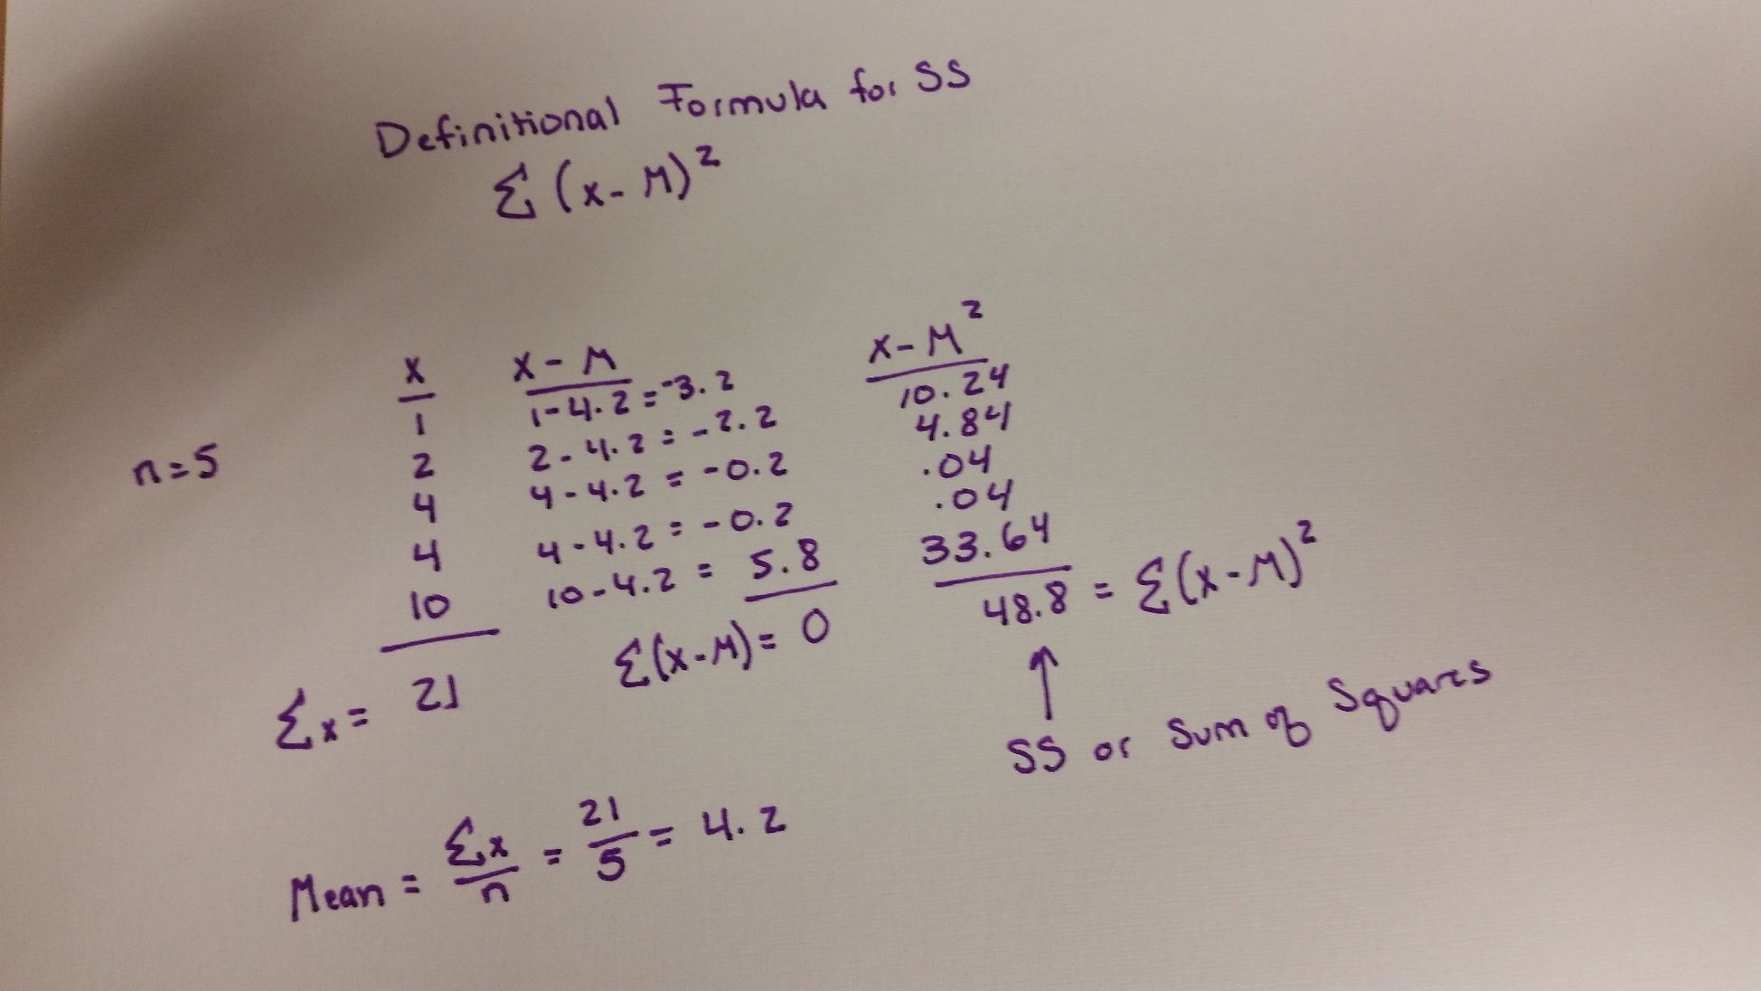
Practice: Answer: SS Definitional Formula
Notes:
Here is my work for calculating the sum of squares using the definitional formula.

Slide 16
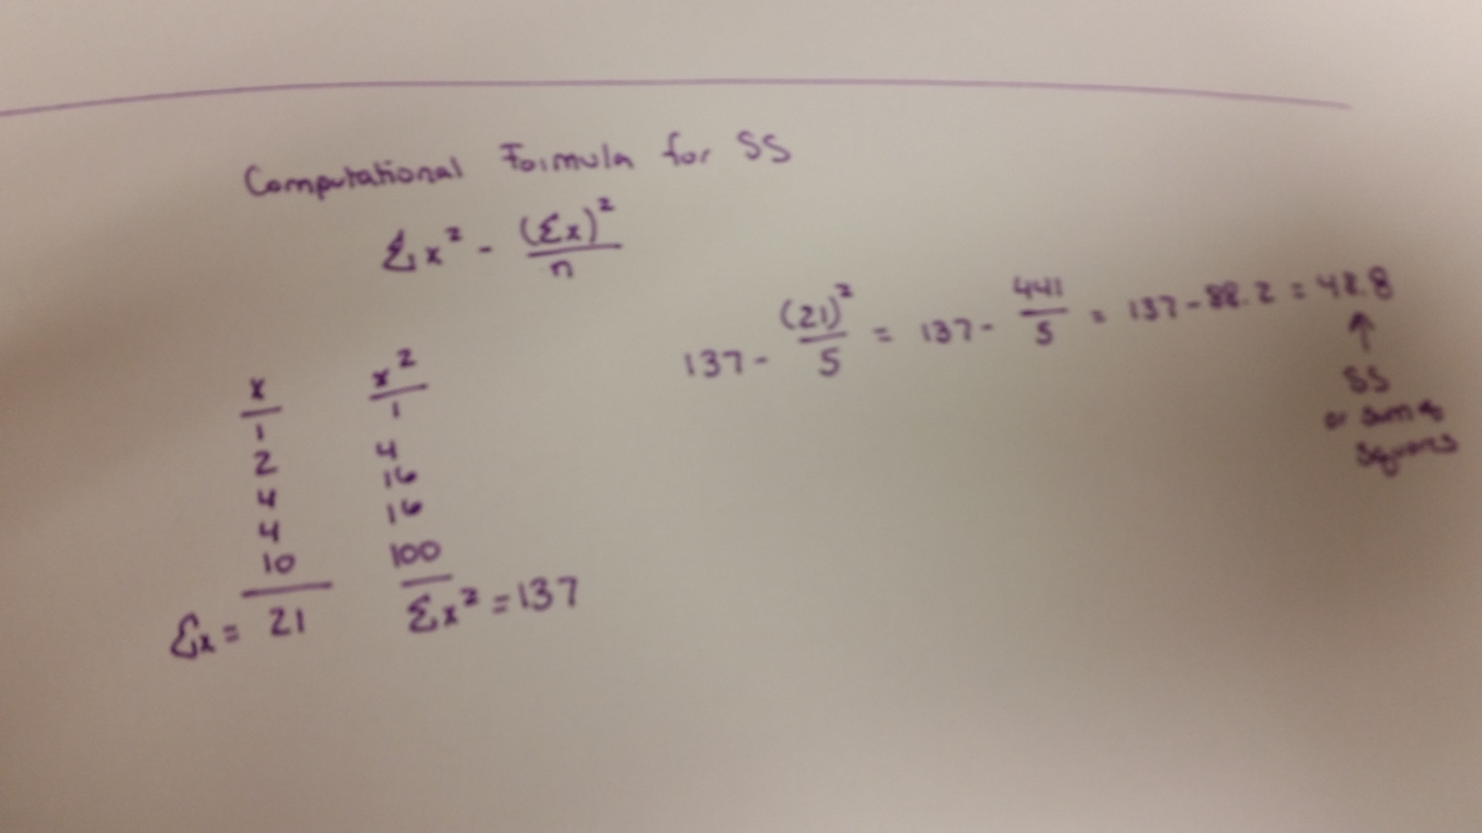
Practice: Answer: SS Computational Formula
Notes:
Here are my notes for calculating the sum of squares using the computational formula.

Slide 17
Practice: Answer: Variance
Notes:
Once I have my sum of squares or SS, which is 48.8, then I divide by n minus one.
Thus, my variance is 12.2.

Slide 18
Population vs. sample variance
Sample symbol for variance
s²
s² ⁼ SS =
N-1
Population symbol for variance
σ²
σ² ⁼ SS =
N
Notes:
How we compute the variance is slightly different depending on whether the data we are using are from a population or from a sample.
Here you see the two formulas
So, we have the familiar sample formula --- and I have the definitional formula for sum of squares presented
The second formula is for a population.
The population symbol for variance is σ² ⁻ pronounced as sigma squared (this is the lower case sigma)
Also, notice, instead of X bar or M (the sample), we are using “mew” (the population mean)
Notice, also that the formulas are basically the same – except for the denominator.
N -1 for a sample
N for a population

Slide 19
Why N -1?
Usually cannot collect data from entire population
Infer population from sample
Problem: Spread of scores in sample tends to be smaller
Dividing by N-1 gives us a more unbiased estimate
Notes:
Why do we divide n -1 instead of n?
In psychological research, we usually cannot collect data from the entire population of interest, instead we typically collect data from a sample.
However, we want to use the data from that sample to make inferences (statements, interpretations, etc.) about the whole population
Because our data only come from a sample, we need to make some adjustments to statistical formulas in order to make these inferences.
We adjust the formula for variance because the spread of the scores in a sample tends to be smaller than the spread of scores in the whole population
Ok, this figure should help explain what I’m talking about.
The population of adult heights forms a normal distribution. If you select a sample from this population using a random method, you are most likely to obtain individuals who are near the population average in height. That is, because most people in the population are centered around the mean, they odds us picking them are higher. On the flip side, there are very few people at the tail ends of the distribution (that are very very short or very very tall). The odds us selecting those people are really low.
As a result, the scores in the sample will tend be less variable (that is, less spread out) than the scores in the population.
By dividing the sum of squares by n-1 rather than n, we come up with a value for the sample variance that is closer to what we would get it we had scores form all people in the population to compute the population variance.
In other words, dividing n-1 gives us a value that is likely to be a more accurate estimate of the population (an unbiased estimate)
N -1 is also the degrees of freedom (more on this later)

Slide 20
Standard deviation
Avg (or typical) deviation of scores from mean
Remember 1, 2, 4, 4, 10 M = 4.2
s² = 12.2
Square root of variance
Square root of 12.2 is 3.49, which makes more sense to us because it takes us back to the original units
Notes:
The other measure of variability that is used in psychology is the standard deviation.
The standard deviation is the most common measure reported to describe the spread of scores
One of the problems with variance is that it’s not very easy to understand at a glance.
Remember the previous scores we had (1, 2, 4, 4, and 10).
We had a sample variance of 12.2. However, the typical score does not vary from the mean by 12.2. I mean scores only range from 1 to 10, so to say that the variance is 12.2 doesn’t translate easily for people.
Remember, the variance calculated based on the squared deviations, not the deviations, and so it is too big.
(we squared the deviations in order to remove the negative signs)
We solve this problem by “unsquaring” it – taking the square root of the variance
The Square root of12.2 is 3.49, which makes much more sense to us. It is on a scale that is comparable to our range of numbers.

Slide 21
Standard deviation
Sample
Population
Variance:
Variance: σ² ⁼
(take square root)
(take square root)
Standard Deviation: s =
Standard Deviation: σ =
Notes:
Ok, so here we see the sample variance and standard deviation side by side with the population variance and standard deviation.
Looks like a lot of different formulas, but to solve for measures of variability there are really just three steps:

Slide 22
Review: Measures of variability
First, compute the sum of squares
Definitional formula: Computational formula:
Notes:
First, compute the sum of squares using either the definitional or computational formula.
Which you have already practiced.

Slide 23
Review: Measures of variability
Second, determine whether your data are for a population or a sample. Then compute the variance term using the sum of squares.
If population: If sample:
σ² = Sum of Squares s² = Sum of Squares
N N -1
Third, find the standard deviation by taking the square root of the variance term
Notes:
Second, determine whether your data is for a population or a sample.
If it is a population you will divide sum of squares by n.
If it is a sample, you will divide sum of squares by n-1.
Third, you’ll find the standard deviation by taking the square root of the variance term

Slide 24
Transformations of scale
Adding/subtracting a constant to each score
Example (population): 1 3 5 7
What is the standard deviation?
SD = 2.24
Add 2 points to each score
What is the new standard deviation?
SD = 2.24
Will not change the standard deviation
Notes:
What happens if we need to transform the scale – say we decide to change it by adding/subtracting a constant to each score.
will not change the standard deviation

Slide 25
Transformations of scale
Multiplying/dividing each score
Example (population): 1 3 5 7
What is the standard deviation?
Already know SD = 2.24
Multiply each score by 2
What is the new standard deviation?
SD = 4.47
Causes SD to be multiplied/divided by the same constant
2 x 2.24 = 4.48
Notes:
Multiplying/dividing each score by a constant
causes the standard deviation to be multiplied/divided by the same constant
(slight differences due to rounding)
2.2360679

Slide 26
Reporting Results in APA format
Report standard deviations when reporting the means
Use statistical abbreviations when the info is in parentheses
“Students in the high-stress condition talked less (M = 22.07, SD = 27.14) than those in the low-stress condition (M = 45.20, SD = 24.97).”

Slide 27
Summarizing Research
Suppose 15 women participate in an experiment designed to examine the effects of sleep deprivation on math performance.
Participants are randomly assigned to one of three groups. Based on their assigned condition, they will be woken after 2 hours of sleep, 4 hours of sleep, or 8 hours of sleep.
Researchers assess the number of errors participants make on a math test.

Slide 28
Summarizing Research
2 hrs/sleep 4 hrs/sleep 8 hrs/sleep
10 8 0
12 8 6
12 10 5
14 8 4
12 6 0
What is the mean number of errors for each condition?
What is the sample (to be used to estimate population) standard deviation for each condition?
Report the findings in APA format.

Slide 29
Summarizing Research
APA Format
Women with eight hours of sleep made fewer errors (M = 3.00, SD = 2.83) than women with four hours of sleep (M = 8.00, SD = 1.41), who made fewer errors than women with two hours of sleep (M = 12.00, SD = 1.41).
Women with eight hours of sleep made fewer errors than women with four hours of sleep, who made fewer errors than women with two hours of sleep (M = 3.00, SD = 2.83; M = 8.00, SD = 1.41; M = 12.00, SD = 1.41; respectively).
You would need to compute an ANOVA to determine if the mean for each condition are significantly different from one another (later lectures).

